Slide 1
Organic Chemistry: Reactions of Hydrocarbons

Slide 2
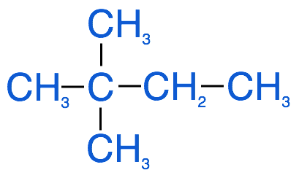
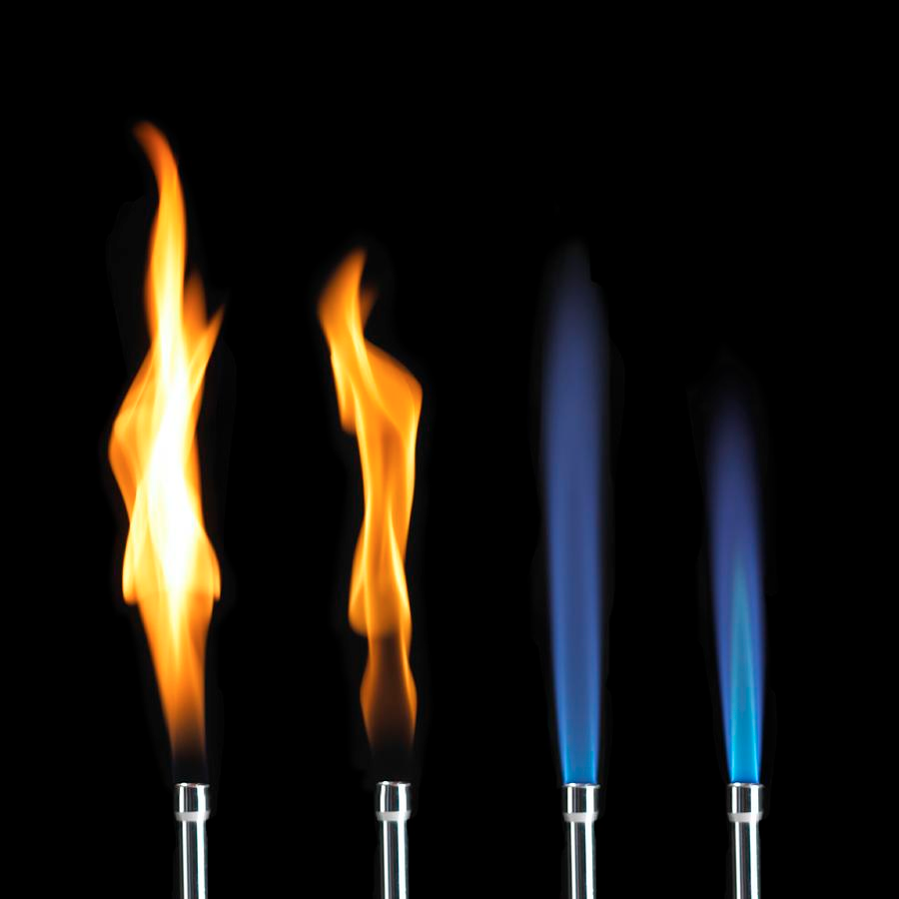
Alkanes
Alkanes are relatively unreactive due to their stable structure
All atoms singly bonded to one another
Alkanes generally require heat and the addition of a catalyst to push reactions forward

Slide 3
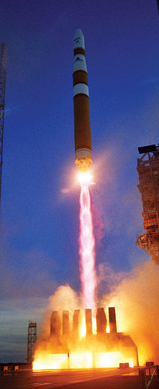
Combustion
Alkanes are typically used as fuel as there is a lot of energy stored within them
This energy can be released and harnessed to help heat homes, power electrical generators, and propel rockets into space
Combustion reactions produce products that are harmful to the environment

Slide 4
Combustion
Combustion is the reaction of a compound with oxygen to produce CO₂, H₂O and thermal energy
The equation for the complete combustion of butane:
2 C₄H₁₀ + 13 O₂ → 8 CO₂ + 10 H₂O + thermal energy
The thermal energy produced from combustion is what is used for power and heat
CO2 contributes to the greenhouse effect → climate change
We need to consider the environmental impact of using hydrocarbons as fuel

Slide 5
Alkanes: Substitution Reactions
AB + CD → AD + BC
2 molecules react with each other, and atoms from each are exchanged and substituted for each other, creating 2 products that are unique from the reactants
Alkyl halides are produced from substitution reactions between hydrocarbons and halogens e.g: chloromethane
These reactions require the input of heat and a catalyst to push them forward
CH₄ + Br₂ → CH₃Br + HBr

Slide 6
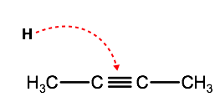
Alkenes & Alkynes Reactions
Alkenes & alkynes are more reactive than alkanes due to the multiple bond
Double and triple bonds are weaker than single bonds, and therefore more reactive
Alkenes & Alkynes undergo different types of addition reactions

Slide 7
Addition Reactions
A + B → AB
2 molecules react with each other and merge to form one product molecule
Different types of addition reactions:
  Hydrogenation
  Halogenation
  Hydration

Slide 8
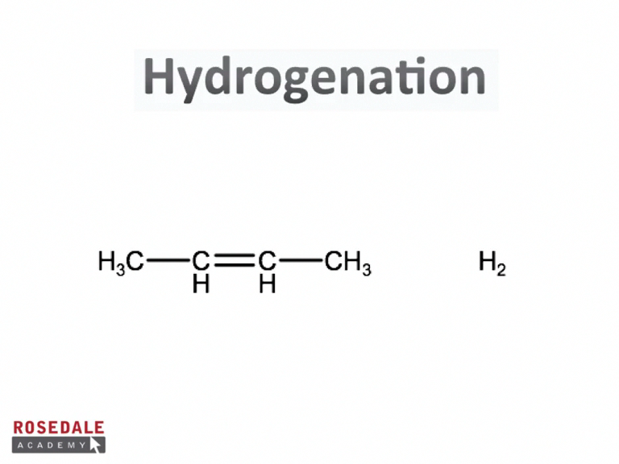
Hydrogenation & Halogenation

Slide 9
Hydrogenation
Hydrogenation reactions turn alkenes, alkynes and cyclic alkenes into alkanes and cycloalkanes
Requires the input of energy to push reaction forward
2-butene + hydrogen → butane
or
CH₃-CH=CH-CH₃ + H₂ → CH₃-CH₂-CH₂-CH₃

Slide 10
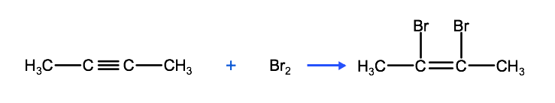
Halogenation
Addition reaction that add halogen atoms to hydrocarbons
Produces alkyl halides from alkenes and hydrogenated alkenes from alkynes
The reaction above produces cis-2,3-dibromobutene which can itself react with Br2 to produce 2,2,3,3-tetrabromobutane

Slide 11
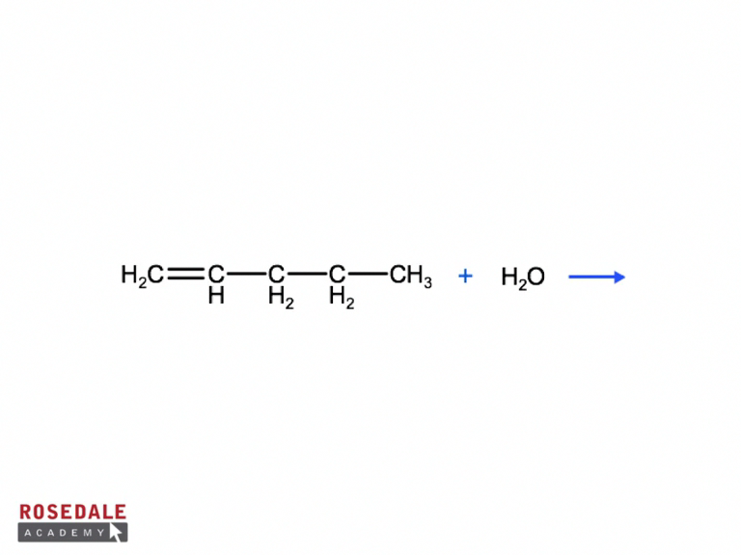
Hydration Reaction

Slide 12
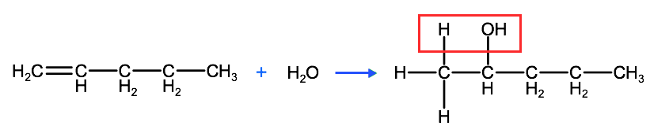
Hydration Reactions
In hydration reactions, water (H2O) molecules react with double or triple bonds adding 1 hydrogen atom and 1 hydroxyl group (-OH)
Hydration reactions produce alcohols
Hydration reactions follow Markovnikov’s rule, in which the hydrogen atom is added to the carbon with the most hydrogen atoms bound to it

Slide 13
Summary
Alkanes involved in complete combustion and substitution reactions
Alkenes and alkynes are more reactive due to weakness of multiple bond
Alkenes and alkynes involved in addition reactions including hydrogenation, halogenation and hydration
Hydration reactions produce alcohols
Markovnikov’s rule: Hydrogens will be added to carbon with the most hydrogen atoms bound to it before the reaction

